Slide 1

Final Project
Victor H Torres
DATA 604.

Slide 2
Using SimPy, write a process simulation that includes waiting time (discrete event simulation).
You may use any topic of interest to you. Write the simulation and all of the following in Jupyter.

Slide 3
I decided to work with the libraries that we used in this class Simpy, Numpy, and matplotlib for graphics
my project is going to be about a simulation of losses of a bank over a period of time, money invested in the stock market, and the value earned of an account over a 10 year period. I am also going to use a random module for this simulation.

Slide 4
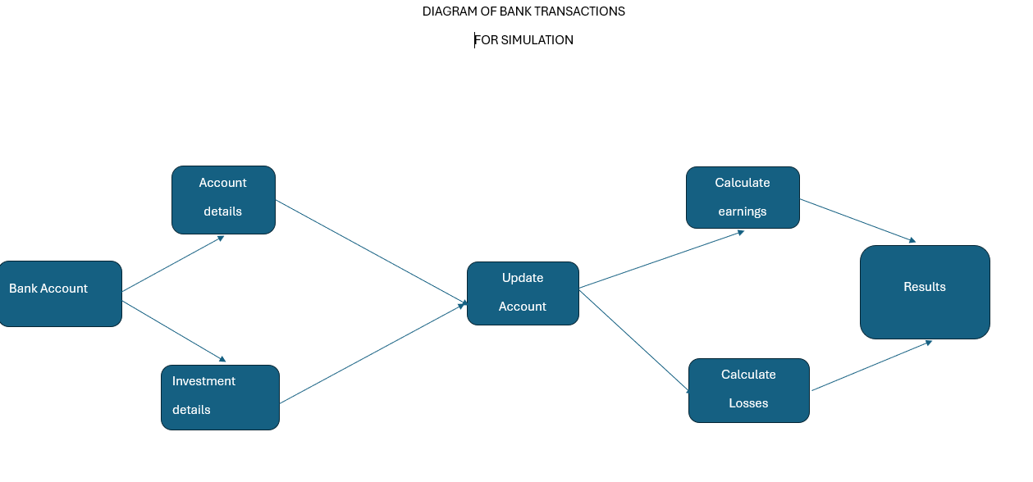

Slide 5
I created several variables for different aspects of the project.
sim_time = 120 # months
account = 0
account_history = []
timestamp = []
inflation_rate = 0.03
equity_growth = 0.07

Slide 6
I declare several functions for all the requisites of the project
def equity_investment(amount):
global account
investment = amount
while True:
yield env.timeout(1)
investment_change = investment * equity_growth/12
account = account + investment_change
investment = investment + investment_change
def multiple_payments(loss, initial_loss, interval, occurrences):
global account
print ('yes')
account = account - initial_loss
account_history.append(account)
timestamp.append(env.now)
for i in range(occurrences):
yield env.timeout(interval)
account = account - loss

Slide 7
Results of Simulation
Month 0 Balance: 0
Month 1 Balance: 1000000
Month 2 Balance: 1003333.3333333334
Month 3 Balance: 1006692.3611111111
Month 4 Balance: 1010077.2175925926
Month 5 Balance: 1013488.0378592786

Slide 8
Conclusion
I was able to create a simulation with Simpy, I use Numpy and Matplotlib as well for this project, I create several functions and variables to obtain the desired results and I was able to display the results of the simulation in the console.

